Slide 1
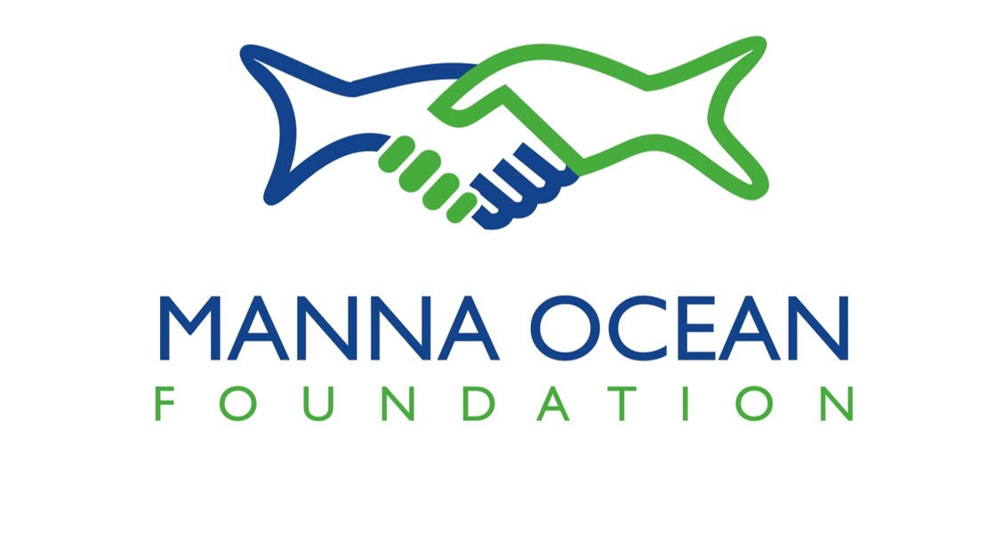
Our Mission: To support sustainable development of aquaculture through education and research.
Notes:
Shells will be replaced with MOF ®

Slide 2
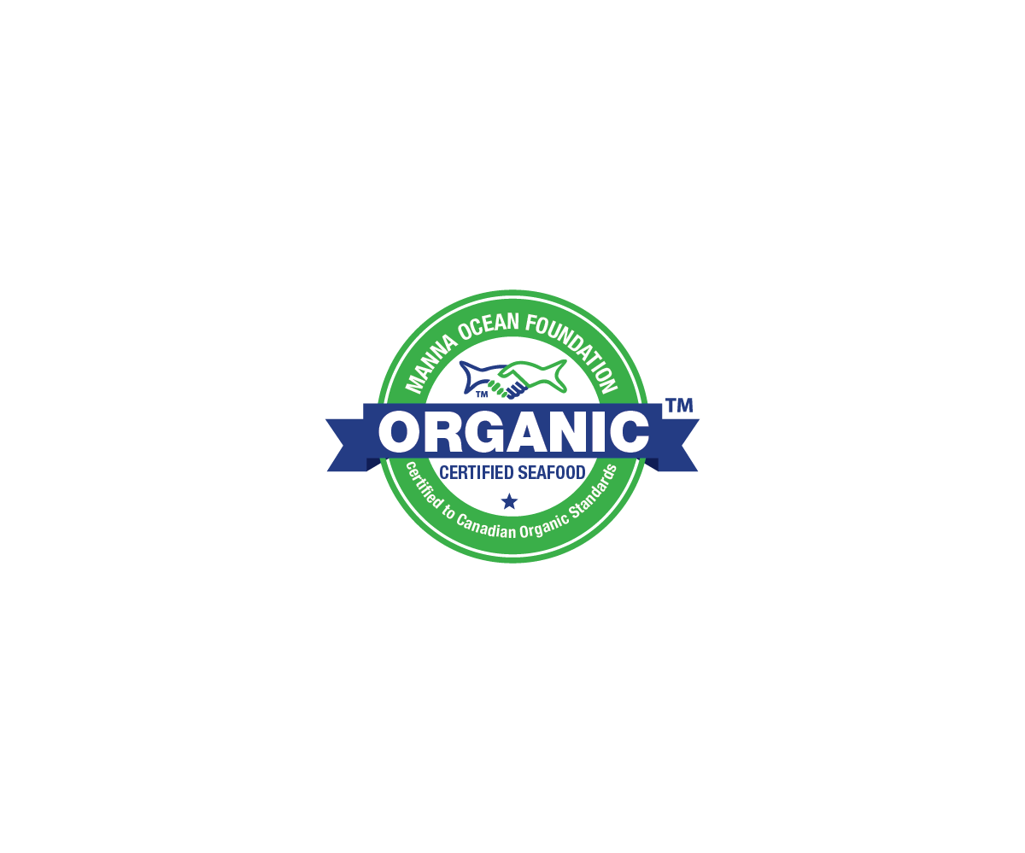
Notes:
Strengths of the BRC standard include highly detailed descriptions of process and hygiene control – this provides management and employees with clear expectations of the day-to-day actions that will contribute to the overall food safety strategy. In other words, highly applicable information that employees can use to deal with real-world situations.

Slide 3
Why are Organics Important?
Currently in the United States, there is no program or standards established to certify farmed seafood as Organic.
Canadian Organic Standards were established in 2012, revised in 2018 and include standards to certify farmed finfish and shellfish.
“Organic aquaculture is a holistic system designed to optimize the productivity and fitness of the aquatic ecosystem, including benthic organisms on the ocean floor, seaweeds, aquatic plants, and aquaculture animals and people.” – Tim Rundle April 2016 Growing Organic.
Universal Understanding & Acceptance
Promote U.S. Seafood & Responsible Farming

Slide 4
Seafood Consumption Stats

Slide 6
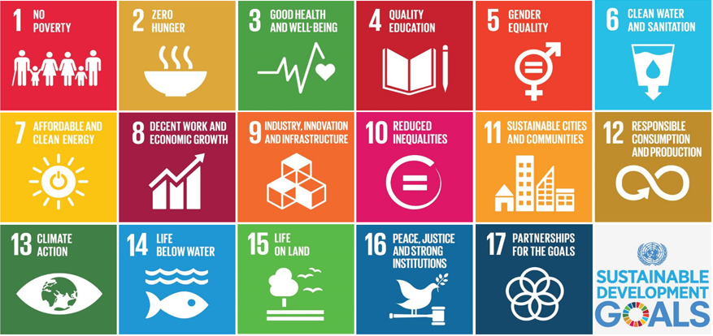
Organics in the Future
United Nations Sustainable Development Goals
Climate Change

Slide 7
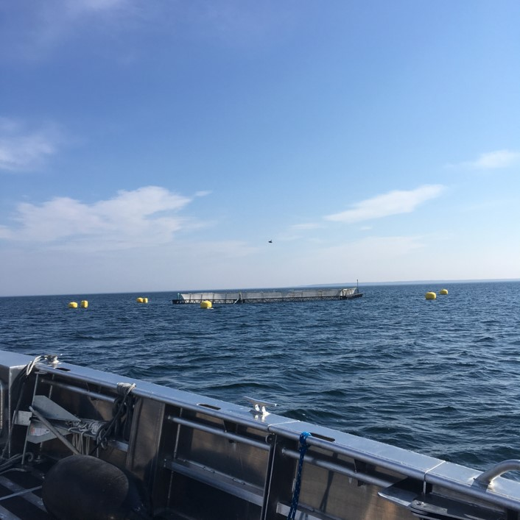
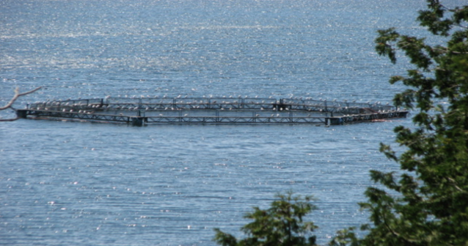
Canadian Organic Standards
Stocking Density
Use of antibiotics
Feed
Notes:
Introduce mike – let him speak about specifics related to the Canadian standards (stocking density, Feed, antibiotics)

Slide 8
MannaOceanFoundation.com Info@mannaoceanfoundation.com 22 inlet road west, Hampton Bays New York 11946
Office – 631-653-9200
Notes:
Full screen of the logo as a background
Contact information – MOF address, email, 9200 phone #, website

